Slide 1
Divide and Conquer Strategy

Slide 2
Counting basket of Coins
Divide them into small buckets and give them to individuals to count
Once individual things are done, then simply sum all of the counts by individuals to get total in the basket

Slide 3
Activity
Count the number of tables in the lab
Some of the students may be chosen and asked to count number of rows in a particular are
Then the answers may be combined
Complexity of problem gets reduced when problem is divided

Slide 4
Divide And Conquer
Divide – break the problem into several subproblems that are similar to the original problem but smaller in size
Conquer – solve the subproblems recursively.
Base case: If the subproblem size is small enough (i.e., the base case has been reached) then solve the subproblem with or without more recursion

Slide 5
Divide And Conquer
Top-down technique for designing algorithms that consists of dividing the problem into smaller subproblems
Partial solutions are combined into the solution of the original problem

Slide 6
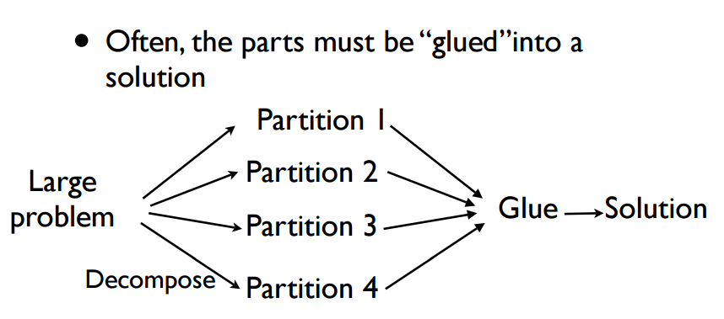
Divide And Conquer

Slide 7
Isogram problem
Given ‘n’ letters find how many isogram words can be formed?
A word is said to be isogram if it is formed without repeating a letter. For example, the word ‘isogram’ itself has the property and ‘Apple’ do not have the property as ‘p’ is repeated in the word

Slide 8
Technique to solve
Length of the word can only be maximum of ‘n’
First letter can be any of the ‘n’ letters
Second letter will be any of the remaining ‘n-1’
Third letter will be any of the remaining ‘n-2’
...
n^{th} letter can be the only one left
Therefore total number of isogram words that shall be formed is
n*(n-1)*(n-2)*...*1

Slide 9
Isogram problem
Input | Output | Alternate Ways for Solution
Number of letters (n) | n! - Factorial of n | Iterative way Or Recursive

Slide 10
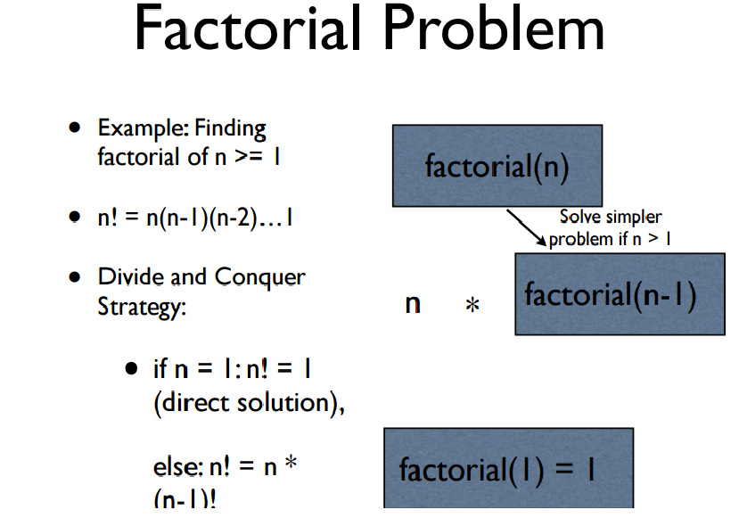

Slide 11
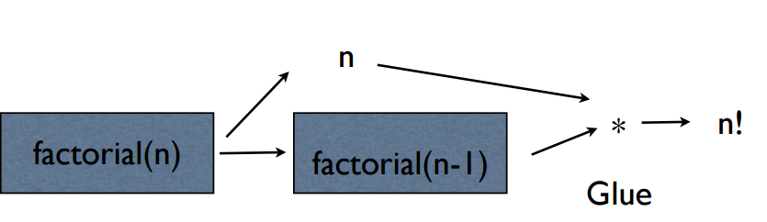

Slide 12
Tower of Hanoi
Mathematical puzzle invented by a French Mathematician Edouard Lucas in 1883
The game consists of three pegs named as source, destination and auxiliary
Starts by having few discs stacked in increasing order of size in the source peg
Objective – All discs must be moved from source peg to destination peg

Slide 13
Rules of the Puzzle
Move only one disc at a time
A larger disc may not be placed on top of a smaller disk
Each move consists of taking the upper disc from one of the rods and sliding it onto another rod

Slide 14
ToH problem
Input | Output | Alternate Ways for Solution
Number of disc in source pole (n) | Description of movements | Iterative way Or Recursive Or bitwise algorithm

Slide 15
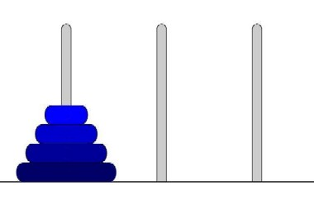
Initial Configuration

Slide 16
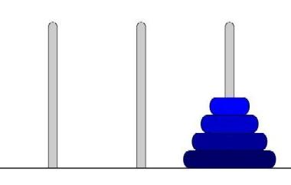
Final Configuration
Suggestion: Play the youtube video
https://www.youtube.com/watch?v=5Wn4EboLrMM

Slide 17
Recursive Algorithm to Solve Tower of Hanoi
When the number of discs is 1
Directly move from source to destination
Otherwise
Move n-1 discs from source to auxiliary peg by using destination peg as intermediate
Move nth disc from source to destination peg
Move n-1 disc from auxiliary peg to destination peg by using source peg as intermediate

Slide 18
Pseudocode for Tower of Hanoi
Solve (N, from, inter, to)
If N is 0
Exit
Else solve (N-1, from, to, inter)
Move from Src to Dst
Solve(N -1 , Aux, Src, Dst)

Slide 19
Pseudocode for Tower of Hanoi
For each call of the function the from, to and inter poles are changed
When n = 4, the function is called for n = 3
When n = 3, the function is called for n =2
When n = 2, the function is called for n = 1
When n=1, base case is reached move disc from ‘from’ pole to ‘to’ pole

Slide 20

Steps of Executing Pseudocode of ToH when n = 4

Slide 21
Change of from, to and inter pegs in call of first solve in pseudocode when n = 4,
Value of ‘n’ | From | To | Inter
4 | Source | Destn | Auxiliary
3 | Source | Auxiliary | Destn
2 | Source | Destn | Auxiliary
1 | Source | Auxiliary | Destn
0 | Source | Destn | Auxiliary

Slide 22
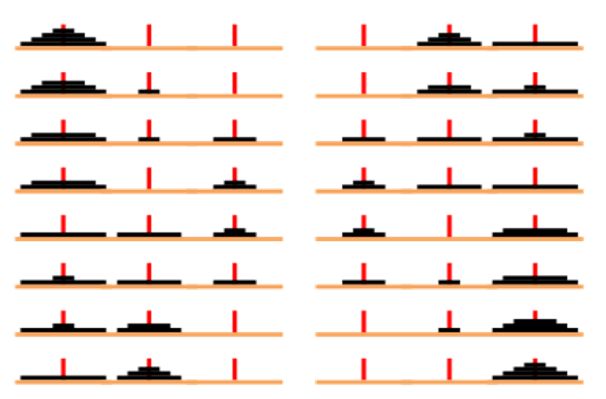
Disc movements

Slide 23
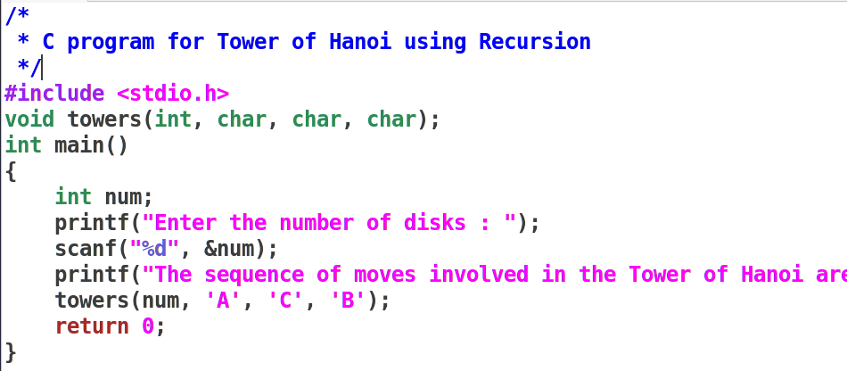

Slide 24
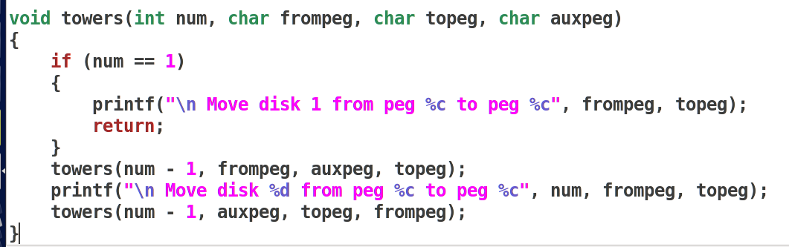

Slide 25

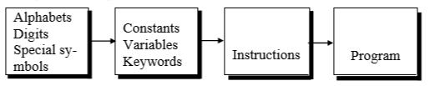
Steps in Learning a Natural Language
Learning a Programming Language

Slide 26
Solve Isogram Problem using Computer
We want to solve the problem in C
Value of ‘n’, the number of letters has to be stored in memory
So we need to store data in memory
So we need to name the location in memory - variable
A group of characters represent a variable name
There are different types of variable based on values that can be stored in the memory
The value of ‘n’ has to be got from the user – scanf in C

Slide 27
Solve it using Computer
Then we have to find n! which is equal to n x (n-1)!
Here n x (n-1) ! is an expression - how expressions are defined in C
Then we have to find (n-1)! Which is (n-1) * (n-2) and so on
An arithmetic expression may have many operators and order of execution is defined by precedence of operators

Slide 28
Solve it using Computer
After computation, we need to show the output in the screen – printf in C
scanf and printf cant' work alone - we need main()

Slide 29
Layout of a C program
pre-processor directives – Preceded by a ‘#’
global declarations – Optional and not a good programming practice
int main() - standard start for all C programs
{
local variables to function main ; - all variables used in the function must be declared in the beginning
statements associated with function main ;
}
void f1()
{
local variables to function 1 ;
statements associated with function 1 ;
}

Slide 30
Components of a C program
A C program consists of the following parts:
Comments
Variables
Preprocessor Commands
Functions
Statements & Expressions

Slide 31
Partial C code for Isogram Problem
/* Code to get the number of letters from user and print it*/
#include<stdio.h>
int main()
{
// Declaration of variable to store number of letters and number // of isogram words
// Get the value of number of letters from user
//If num_Of_Letters in less than or equal to zero then error
// multiply all numbers from n to 1 to find number of
// isogram words that can be formed
// print the number of isogram words can be formed
}

Slide 32
Comments in C
Two types of comments
Single line and multi line comment
Single Line Comment is double forward slash ‘//’ and can be Placed Anywhere

Slide 33
Multiline Comments in C
Multi line comment can be placed anywhere
Multi line comment starts with /*
Multi line comment ends with */
Any symbols written between '/*’ and '*/‘ are ignored by Compiler

Slide 34
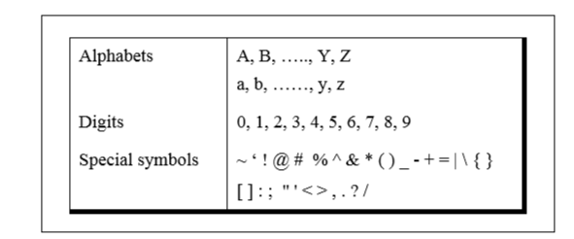
Character set of C

Slide 35
Constants, Variables and Keywords
alphabets, numbers and special symbols when properly combined form constants, variables and keywords
Constant - entity that doesn’t change
Variable - entity that may change
Keyword – reserved in programming language (Equivalent to words in natural language with predefined meaning)

Slide 36
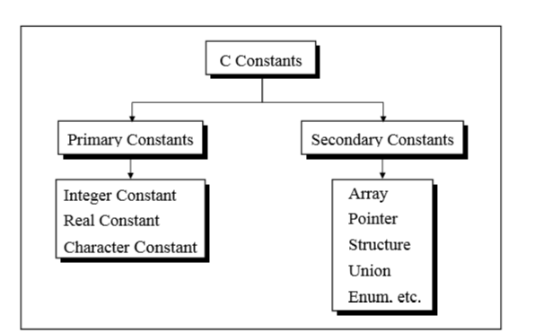
Types of C Constants
Now Restrict Discussion to Primary Constants

Slide 37
Rules for Constructing Integer Constants
Must have at least one digit
Must not have a decimal point
Can be either positive or negative
If no sign precedes then it is assumed to be +ve
No commas or blanks are allowed
GCC is a 32-bit compiler therefore 4 bytes are allocated
Range of values -2,147,483,648 to 2,147,483,647

Slide 38
What will be the Output of code?
#include<stdio.h> void main() { printf("%d",2147483649); //printf("%ld",sizeof(int)); }
gcc first.c
./a.out

Slide 39
Output
warning: format ‘%d’ expects argument of type ‘int’, but argument 2 has type ‘long int’ [-Wformat]
-2147483648

Slide 40
Real Constants
Two forms
Fractional Form
Exponential Form

Slide 41
Rules for Fractional Form Real Constants
Must have at least one digit
Must have a decimal point
Could be either positive or negative
Default sign is positive
No commas or blanks are allowed within a real constant
Eg: +325.34, 426.0 , -32.76, -48.5792

Slide 42
Exponential Form of Real Constants
Represented as two parts separated by a ‘e’
Part appearing before ‘e’ is called mantissa, whereas the part following ‘e’ is called exponent

Slide 43
Rules for Exponential Form Real Constants
Both parts should have atleast one digit
Mantissa can be a real constant in fractional form
Exponent can only be integers
Both parts may have a positive or negative sign
Default sign of both parts is positive
Range of real constants expressed in exponential form is -3.4e38 to 3.4e38
Eg: +3.2e-5 4.1e8 -0.2e+3 -3.2e-5

Slide 44
Rules for Constructing Character Constants
A character constant is a single alphabet, a single digit or a single special symbol enclosed within single inverted commas
Maximum length of a character constant can be 1 character
Eg: 'A' 'I' '5' '='

Slide 45
Types of C Variables
Variable names - Names given to locations in memory
Locations can contain integer, real or character constants
In any language, types of variables supported depend on the types of constants that it can handle
Because a particular type of variable can hold only same type of constant
Integer variable - integer constant, real variable - real constant and a character variable - a character constant

Slide 46
Rules for Constructing Variable Names
Rules for constructing variable names of all types are same
Combination of 1 to 31 alphabets, digits or underscores
Some compilers allow up to 247 characters but safer to 31 characters
First character must be an alphabet or underscore
No commas or blanks are allowed
No special symbol other than an underscore
Eg: si_int m_hra pop_e_89

Slide 47
Data types in C
Basic Arithmetic types - further classified into: (a) integer types and (b) floating-point types
Enumerated types - arithmetic types that are used to define variables that can be assigned only certain discrete integer values throughout the program
Type void - indicates that no value is available
Derived types - They include (a) Pointer types, (b) Array types, (c) Structure types, (d) Union types and (e) Function types

Slide 48
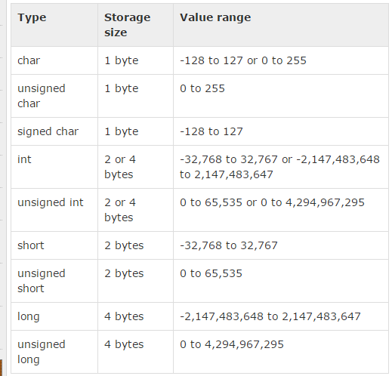
Integer Types

Slide 49
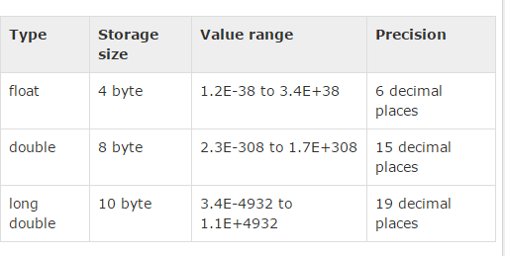
Floating Point Types

Slide 50
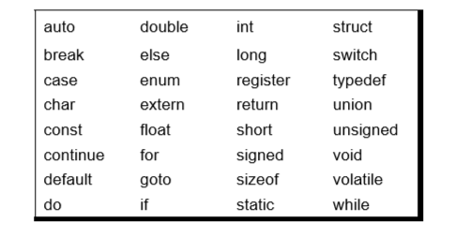
Keywords
32 keywords available in C
Compiler vendors (like Microsoft, Borland, etc.) provide their own keywords

Slide 51
Discuss Valid and Invalid variable names
BASICSALARY
_basic
basic-hra
#MEAN
group.
422
population in 2006
FLOAT
hELLO

Slide 52
I/O in C
Basic operation in any language
Input is got through a function scanf which is equivalent to input or raw_input in Python
Syntax of scanf
int scanf(const char *format, ...)
Basically two or more arguments
First format string, followed by address of variables that are going to hold values entered by user

Slide 53
I/O in C
int printf(const char *format, ...)
contains one or more arguments
first argument is the format string

Slide 54
printf and scanf format codes
code | type | format
d | int | decimal (base ten) number
o | int | octal number (no leading '0' supplied in printf)
x or X | int | hexadecimal number (no leading '0x' supplied in printf; accepted if present in scanf) (for printf, 'X' makes it use upper case for the digits ABCDEF)
ld | long | decimal number ('l' can also be applied to any of the above to change the type from 'int' to 'long')

Slide 55
printf and scanf format codes
code | type | format
u | Unsigned int | decimal number
lu | unsigned long | decimal number
c | char [footnote] | single character
s | char pointer | string
f | float [footnote] | number with six digits of precision
lf | double [footnote] | number with six digits of precision

Slide 56
Address of a variable
Address of a variable can be obtained by putting a ‘&’ before the variable name

Slide 57
Arithmetic instructions in C
To perform arithmetic operations between constants and variables
Operands shall be either constant or variables
Variables can be of any type of integer or floating point value or character except for modulus operator
Modulus operator cannot be applied for floating point values but can be applied for integer and character types

Slide 58
Example 1
#include<stdio.h> void main() { int a = 27; int b = 25; int c = a -b; printf("%d",c); }

Slide 59
Output 1
2

Slide 60
Example 2
#include<stdio.h> void main() { char a = 273; char b = 25; int c = a%b; printf("%d",c); }

Slide 61
Output 2
warning: overflow in implicit constant conversion [-Woverflow]
17
Character – range is 0 to 255
256 is 0
257 is 1 and so on

Slide 62
Example 3
#include<stdio.h> void main() { char a = 27; char b = 25; char c = a -b; printf("%c",c); }

Slide 63
Output 3
A special character

Slide 64
Arithmetic Operators in C
Operator | Description
+ | Adds two operands
− | Subtracts second operand from the first.
∗ | Multiplies both operands
∕ | Divides numerator by denominator
% | Modulus Operator and remainder of after an integer division.
++ | Increment operator increases the integer value by one
-- | Decrement operator decreases the integer value by one

Slide 65
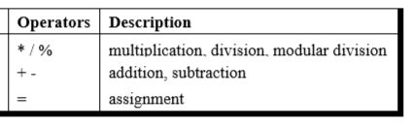
Precedence of Operators in C
++, -- Post increment Operators
++, -- Pre increment Operators
Parenthesis can be used to override default precedence

Slide 66
Example 4
#include<stdio.h> main() { int a, b,c; a = 4; b = 2; c = -a+--b; printf ( "c = %d", c) ; }

Slide 67
Output 4
c = -3

Slide 68
Example 5
#include<stdio.h> main() { int a, b,c; a = 4; b = 2; c = -a+ b--; printf ( "c = %d", c) ;
printf ( "b = %d", b) ; }

Slide 69
Output 5
c = -2
b = 1

Slide 70
Example 6
#include<stdio.h> main() { int a, b,c; a = 4; c = ++a + a++; printf ( "c = %d", c) ; printf ( "a = %d", a) ; }

Slide 71
Output 6
c = 10 a = 6

Slide 72
Example 7
#include<stdio.h> main() { int a, b,c; a = 4; c = ++a + ++a; printf ( "c = %d", c) ; printf ( "a = %d", a) ; }

Slide 73
Output 7
c = 12 a = 6

Slide 74
Example 8
#include<stdio.h> main() { int a, b,c; a = 4; c = a++ + ++a; printf ( "c = %d", c) ; printf ( "a = %d", a) ; }

Slide 75
Output 8
c = 10 a = 6

Slide 76
Associativity of Operators in C
When precedence of two operators are same then associativity of operator is considered for evaluation

Slide 77
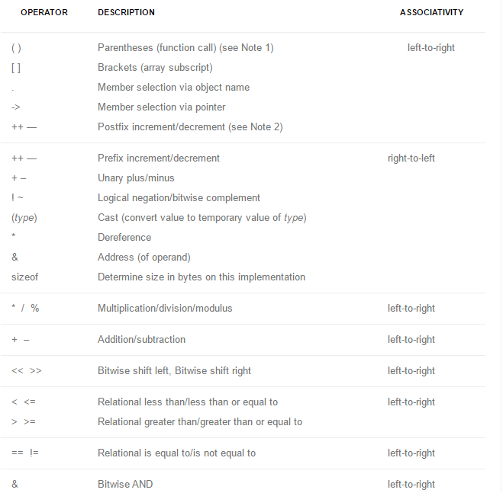

Slide 78
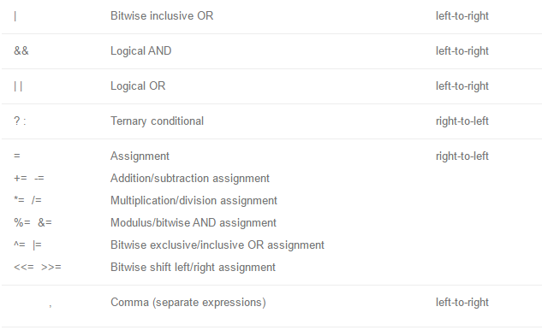

Slide 79
Partial C code for Isogram Problem
/* Code to get the number of letters from user and print it*/
#include<stdio.h>
int main()
{
int num_Of_Letters; // Declaration of variable is mandatory in C
int num_Of_Words ; // Memory is allocated but not initialized
scanf(“%d”,&num_Of_Letters);
//If num_Of_Letters in less than or equal to zero then error
printf(“Number of letters is %d”,num_Of_Letters);
// multiply all numbers from n to 1 to find number of
// number of isogram words that can be formed
}

Slide 80
Compile and Run
Compile and run the program named as isogram.c
gcc isogram.c – to compile
./a.out – to run

Slide 81
Automatic Type Conversion in C
Convert a variable from one data type to another data type
When the type conversion is performed automatically by the compiler without programmers intervention, such type of conversion is known as implicit type conversion or type promotion.
The compiler converts all operands into the data type of the largest operand.

Slide 82
Rules for Implicit Type Conversion in C
Sequence of rules that are applied while evaluating expressions are given below:
All short and char are automatically converted to int, then,
If either of the operand is of type long double, then others will be converted to long double and result will be long double.
Else, if either of the operand is double, then others are converted to double.
Else, if either of the operand is float, then others are converted to float.

Slide 83
Rules for Type Conversion in C
Else, if either of the operand is unsigned long int, then others will be converted to unsigned long int.
Else, if one of the operand is long int, and the other is unsigned int, then
if a long int can represent all values of an unsigned int, the unsigned int is converted to long int.
otherwise, both operands are converted to unsigned long int.
Else, if either operand is long int then other will be converted to long int.
Else, if either operand is unsigned int then others will be converted to unsigned int.

Slide 84
Example 9
#include<stdio.h> void main() { char a = 65; char b = 100; int c = a%b; printf("%c",c); }

Slide 85
Output 9
A

Slide 86
Example 10
#include<stdio.h> void main() { int a = 165; int b = 100; int c = a/b; printf("%d",c); }

Slide 87
Output 10
1

Slide 88
Example 11
#include<stdio.h> void main() { int a = 165; int b = 100; float c = a/b; printf("%f",c); }

Slide 89
Output 11
- 1.000000

Slide 90
Example 12
#include<stdio.h> void main() { int a = 165; int b = 100; float c = a/b; printf("%f",c); }

Slide 91
Output 12
- 1.000000

Slide 92
Example 13
#include<stdio.h> void main() { int a = 165; float b = 100; float c = a/b; printf("%f",c); }

Slide 93
Output 13
- 1.650000

Slide 94
Explicit Type Conversion
Type conversion performed by the programmer is known as explicit type conversion
Explicit type conversion is also known as type casting.
Type casting in c is done in the following form:
(data_type)expression;
where, data_type is any valid c data type, and expression may be constant, variable or an expression
For example, x=(int)a+b*d;

Slide 95
Explicit Type Conversion
The following rules have to be followed while converting the expression from one type to another to avoid the loss of information:
All integer types to be converted to float.
All float types to be converted to double.
All character types to be converted to integer.

Slide 96
Example 14
#include<stdio.h> void main() { int a = 165; int b = 100; float c = (float)(a/b); printf("%f",c); }

Slide 97
Output 14
1.000000

Slide 98
Example 15
#include<stdio.h> void main() { int a = 165; int b = 100; float c = (float) a/b; printf("%f",c); }

Slide 99
Output 15
1.650000

Slide 100
Assignment
Students have to check all operators for all types of operands, also work on to understand precedence of operators

Slide 101
Scope and Lifetime of a Variable in C Language
Life Time of a variable - Time for which the particular variable outlives in memory during execution of program
Scope of a variable - Area of our program where we can actually access the variable

Slide 102
Global vs Local Scope
Global scope :
When variable is defined outside all functions.
It is then available to all the functions of the program and all the blocks program contains.
Local scope :
When variable is defined inside a function or a block, then it is locally accessible within the block and hence it is a local variable.

Slide 103
Global vs Local Scope
int global = 100; // global variable declared
void main()
{
int local = 10; // local variable declared
printf("Global variable is %d",global);
printf("Local variable is %d",local);
func1();
}
void func1()
{
printf("Global inside func1 is %d",global);
}

Slide 104
Storage Classes in C
Four Storage Classes, classified based on life and scope of access:
Storage Class | Life | Scope
Auto | Created when a function is called and destroyed automatically when function exits Default – int n; | Can be accessed only within the function where it is declared
Register | Similar to Auto but stored in register, a faster memory. Number of register is limited. Therefore automatically converted to auto if necessary register int number; | Similar to Auto

Slide 105
Storage Classes in C
Storage Class | Life | Scope
Static | Created when a function is called Mandatory for programmer to initialize Lives till the program executes static int n =10; | Accessible only inside the function where it is defined
Extern | Created when the program execution starts extern int n; | Global variables that can be shared across files

Slide 106
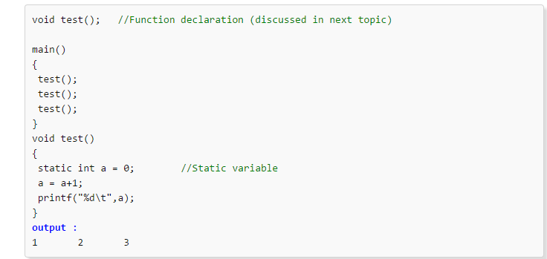
Static in C

Slide 107
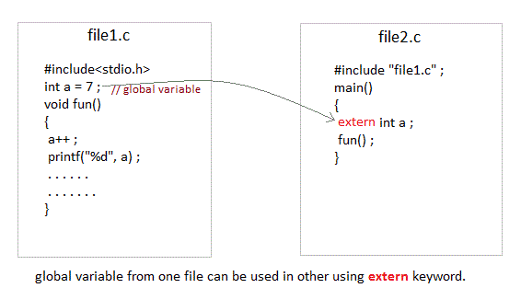
Extern in C

Slide 108
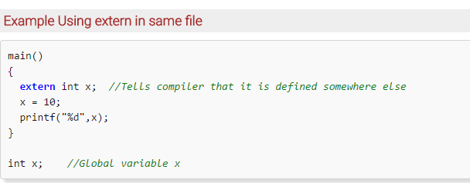
Extern in C

Slide 109
Declaration and Definition of Variables in C
Declaration – Information to compiler about the variable
Definition – Memory is allocated for the variable according to type
For all storage classes declaration and definition are same except for extern
When a keyword extern precedes, its only a declaration and the compiler waits for definition without raising error

